Slide 1



Correlating Wall Shear Stress to Heat Distribution in a Pipe Under Unsteady Fluid Flow
Edwin Beraud, Mohammadreza Soltany Sadrabadi, Mostafa Mahmoudi, Ali Farghadan, Amirhossein Arzani
Department of Mechanical Engineering
Northern Arizona University

Slide 2
Importance of this Research
-Heat transfer in pipes with a fluid within them tends to be used to remove waste heat from energy conversion systems like computers, cell phones, and satellite systems, etc.
-Calculating heat transfer on surfaces needs ample computational power and mathematics for engineers to develop cooling systems.
-This research intends to show wall shear stress (WSS) can be used to study heat transfer near the wall of complex geometries to reduce computational loads.

Slide 3
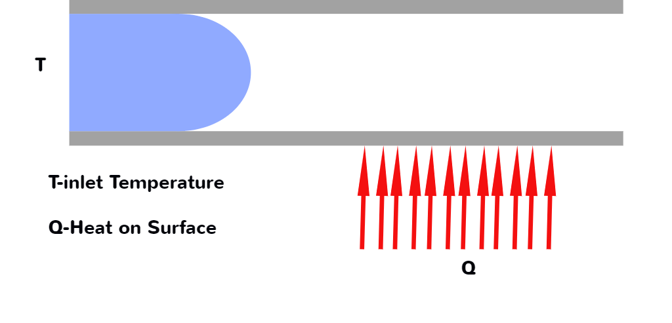
Purpose of this Research
-Find the heat distribution on the surface walls of a complex geometry with flowing water under complex flow conditions.

Slide 4
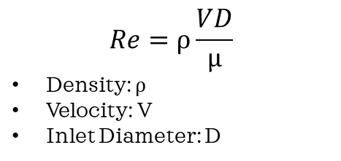
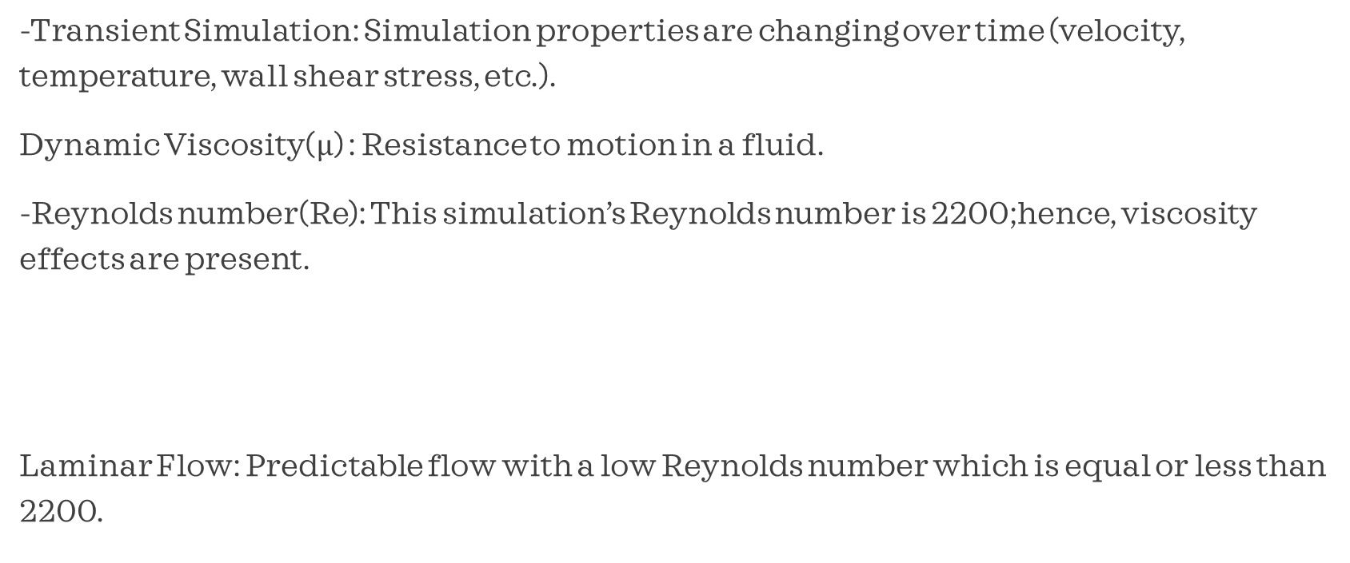
Simulation Characteristics
-Transient Simulation: Simulation properties are changing over time (velocity, temperature, wall shear stress, etc.).
Dynamic Viscosity($µ$) : Resistance to motion in a fluid.
-Reynolds number(Re): This simulation’s Reynolds number is 2200;hence, viscosity effects are present.
Laminar Flow: Predictable flow with a low Reynolds number which is equal or less than 2200.
$$Re=⍴\frac{VD}{µ}$$
Density: $⍴$
Velocity: V
Inlet Diameter: D

Slide 5
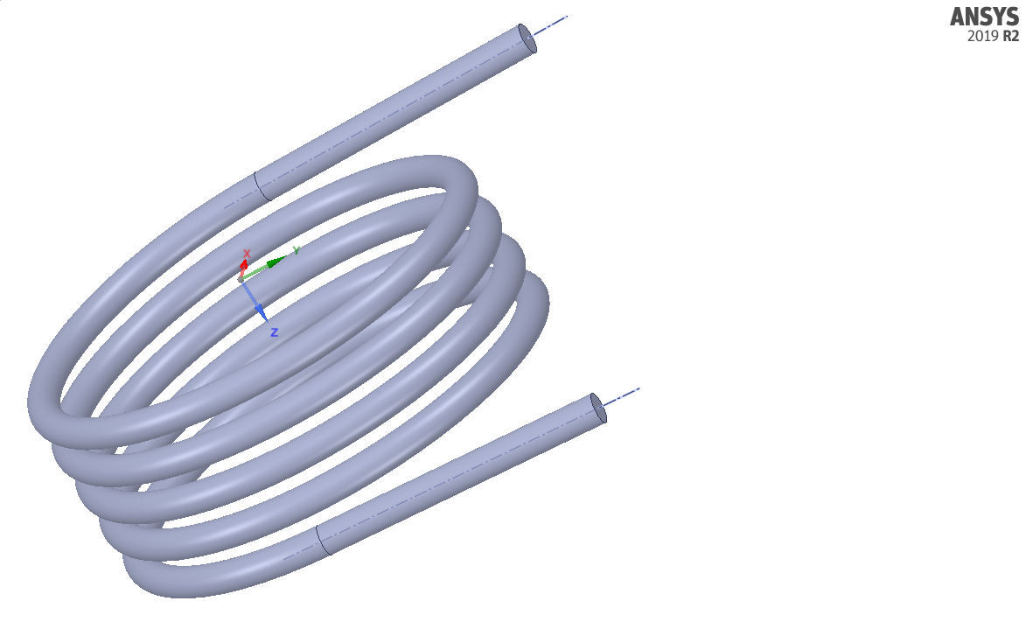
Methodology
1)-Creating a SolidWorks model for a helix geometry and loading it ANSYS for analysis.
Helix Structure Specifications:
Revolutions: 4.5
Outer Diameter: 300mm
Height: 131.18 mm
Pipe Diameter: 20.80mm
Pipe Extensions: 200mm
Helix structure developed in SolidWorks

Slide 6
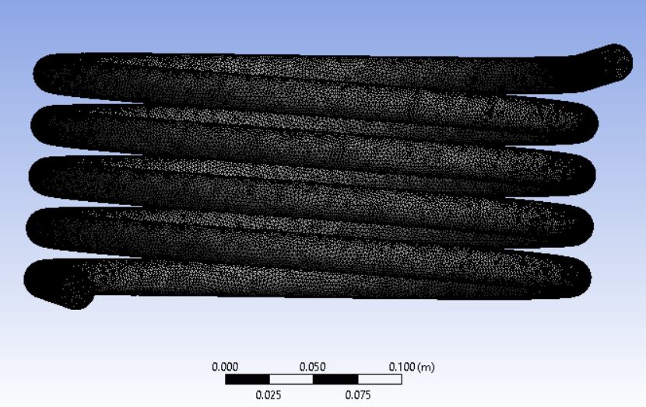
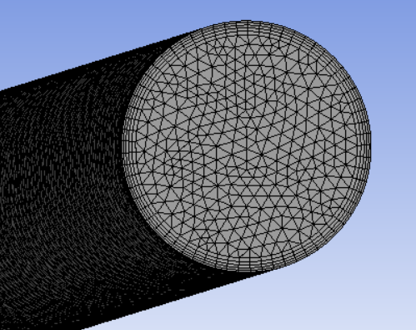
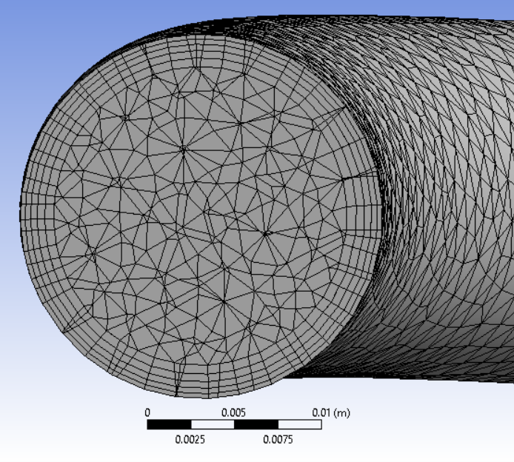
Methodology
2)-Creating a mesh in ANSYS to capture spatial temporal Temperature, Velocity and Wall Shear Stress distribution.
Mesh Details:
Element Size: 0.001m
Number of Elements: 2M
On the left, the mesh for the inlet/outlet is displayed. On the right, the internal mesh of the geometry is shown.
External mesh on the geometry.

Slide 7
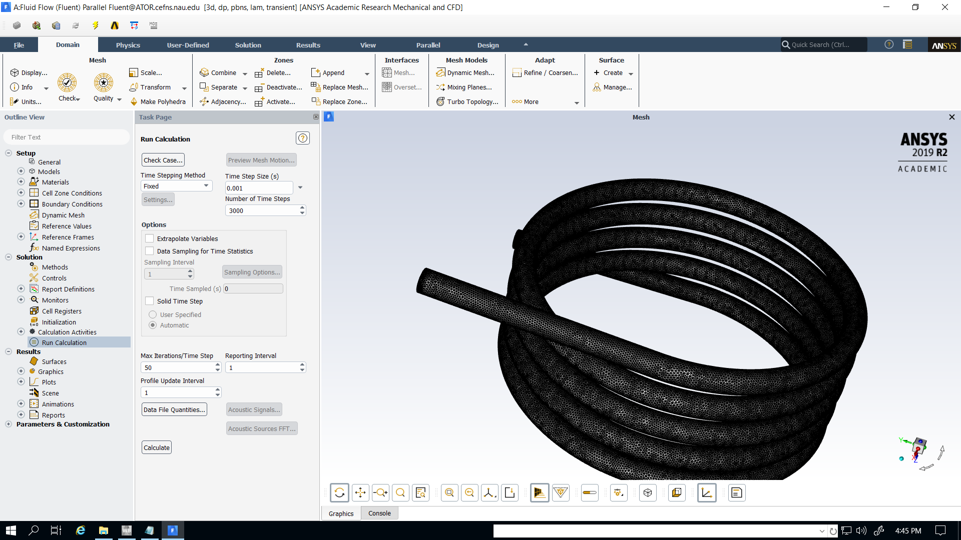
Methodology
3)-Running Fluent simulation of water running through pipe to gain data of properties.
Fluent Specifications
Velocity Profile: Pulsatile
Inlet Temperatures: 300 K
Heat Flux on Walls: 2000 W/ m^2
Time Simulated: 3 seconds
Fluent Simulation.

Slide 8
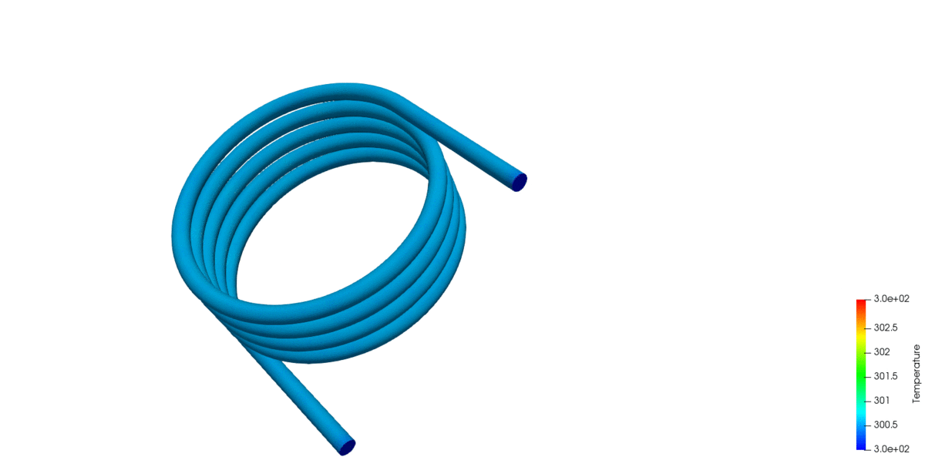
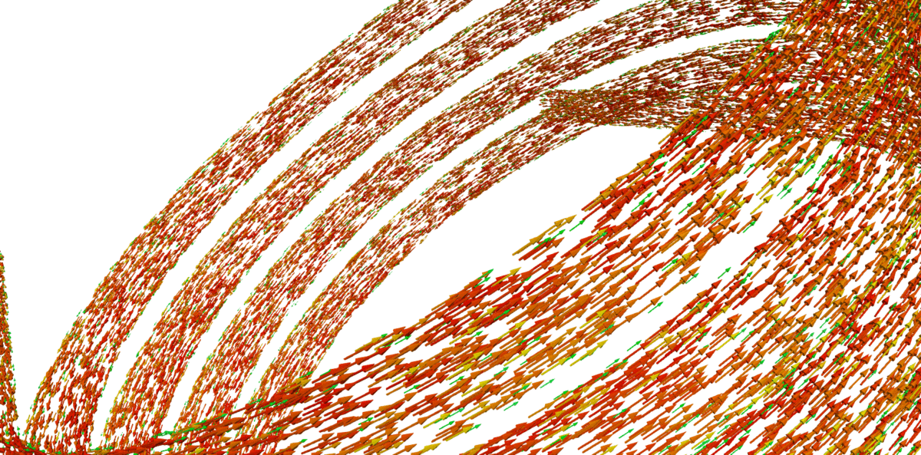
Fluent Simulation Results
Velocity profile in the helical structure.
Temperature distribution in the helix structure.

Slide 9
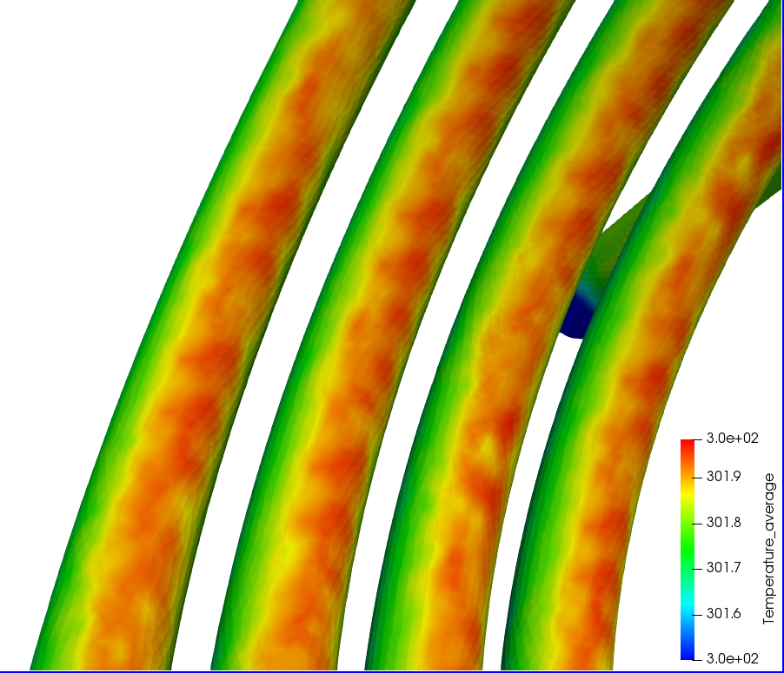
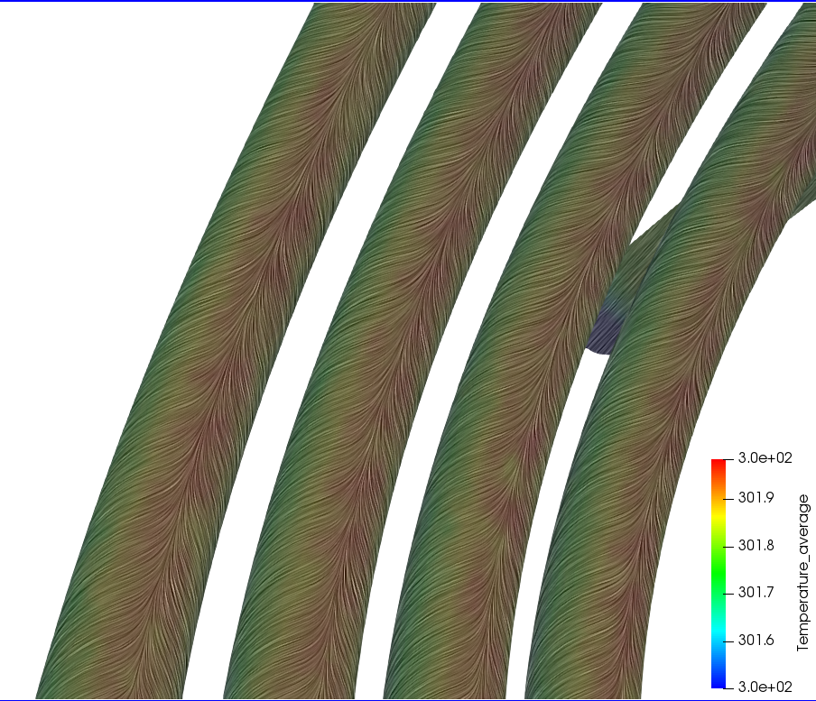
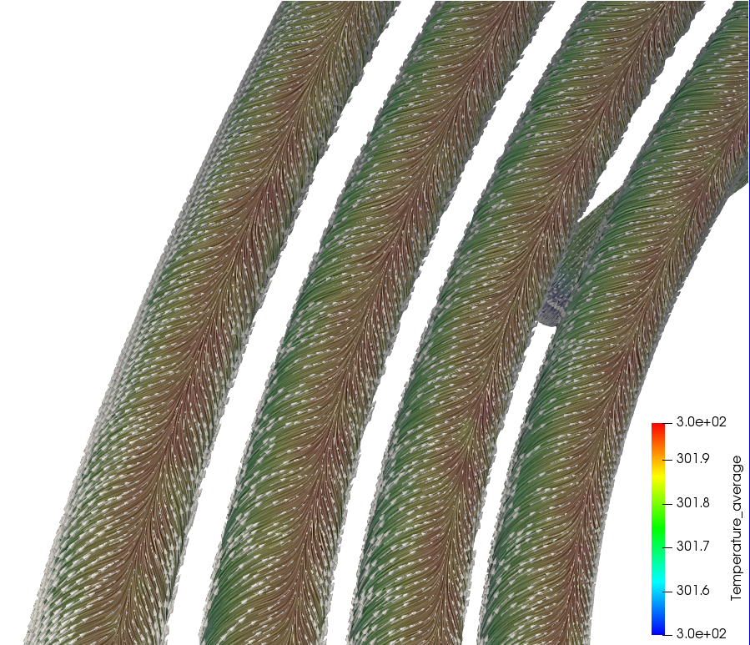
Results
The visuals show time average temperature, WSS vectors using Surface Line Integral Convolution (LIC) and normalized time average wall shear stress vectors being overlapped.
Time average temperature distribution in helix structure.
Surface LIC of time average WSS vectors imposed on time average temperature distribution.
Time average WSS vectors in conjunction with surface LIC imposed on time average temperature distribution.

Slide 10
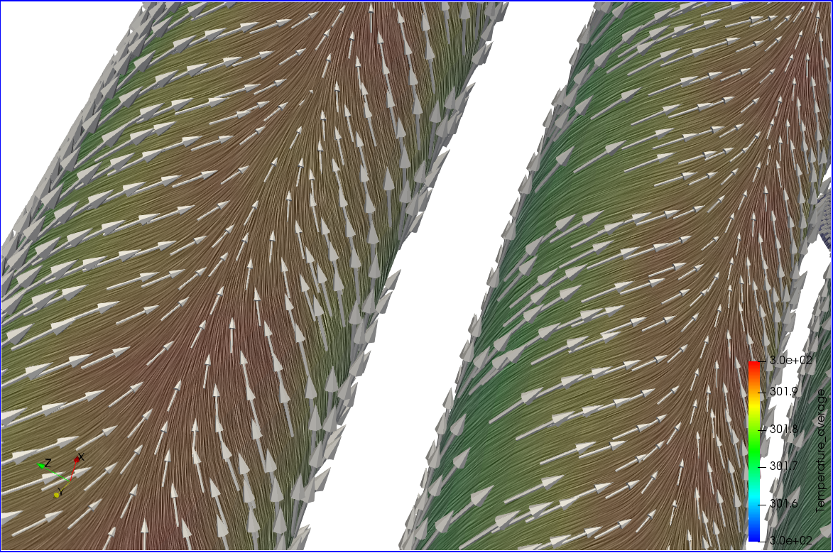
Results
The topology of WSS vectors (herein, converging vectors) dictate surface temperature.
Zoomed in vector view where time average WSS converges towards the hottest sections in the geometry.

Slide 11
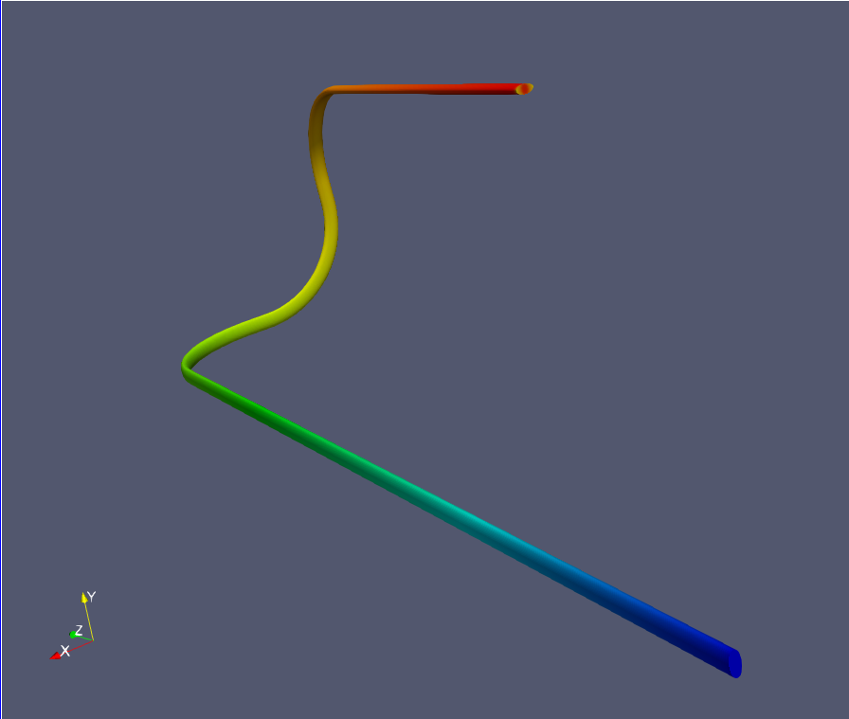
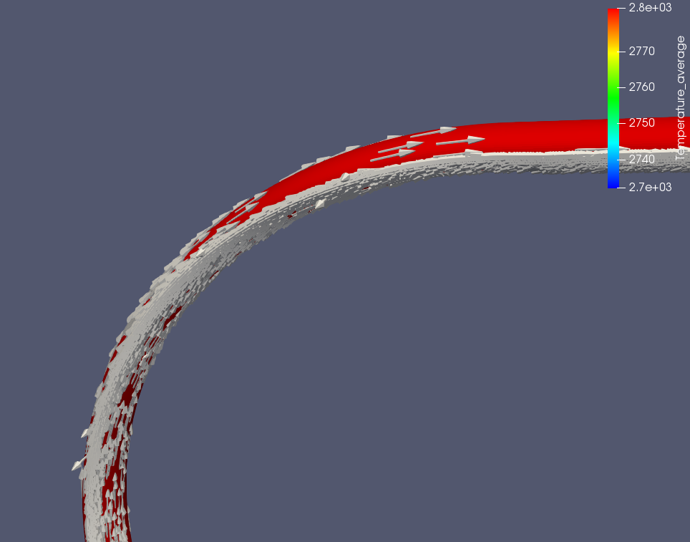
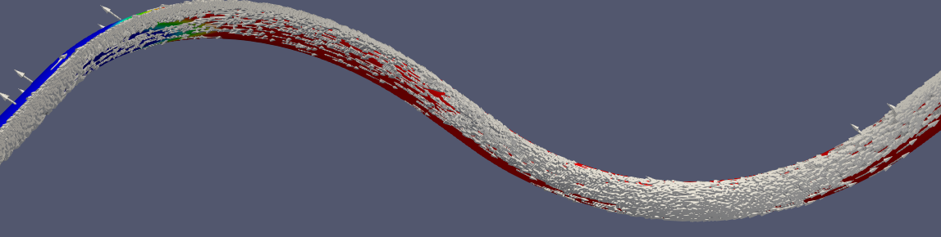
Final Notes
If a geometry does not yield complex WSS vector patterns, but instead produces unidirectional patterns then a uniform spatial temperature distribution can be seen.
Vector distributions in different sections of the geometry.
Uniform spatial temperature distribution in complex geometry.

Slide 12

Acknowledgements
A special thanks to all the sponsors and professional researchers that helped me with this project!
https://www.cardiolab.nau.edu

Slide 13
References:
[1]R. Fox, A. McDonald and P. Pritchard, Introduction to Fluid Mechanics, 9th ed. New Delhi, India: J. Wiley, 2012.
[2]L. Janssen and C. Hoogendoorn, "Laminar convective heat transfer in helical coiled tubes", International Journal of Heat and Mass Transfer, vol. 21, no. 9, pp. 1197-1206, 1978. Available: 10.1016/0017-9310(78)90138-2 [Accessed 23 February 2020].
[3]J. S.Jayakumar, "Helically Coiled Heat Exchangers", Heat Exchangers - Basics Design Applications, 2012. Available: 10.5772/22242 [Accessed 23 February 2020].
[4]A. Arzani, A. Gambaruto, G. Chen and S. Shadden, "Lagrangian wall shear stress structures and near-wall transport in high-Schmidt-number aneurysmal flows", Journal of Fluid Mechanics, vol. 790, pp. 158-172, 2016. Available: 10.1017/jfm.2016.6 [Accessed 23 February 2020].
[5]P. Grenson and H. Deniau, "Large-Eddy simulation of an impinging heated jet for a small nozzle-to-plate distance and high Reynolds number", International Journal of Heat and Fluid Flow, vol. 68, pp. 348-363, 2017. Available: 10.1016/j.ijheatfluidflow.2017.09.014 [Accessed 23 February 2020].

